Slide 1

Breast Cancer Research

Slide 2
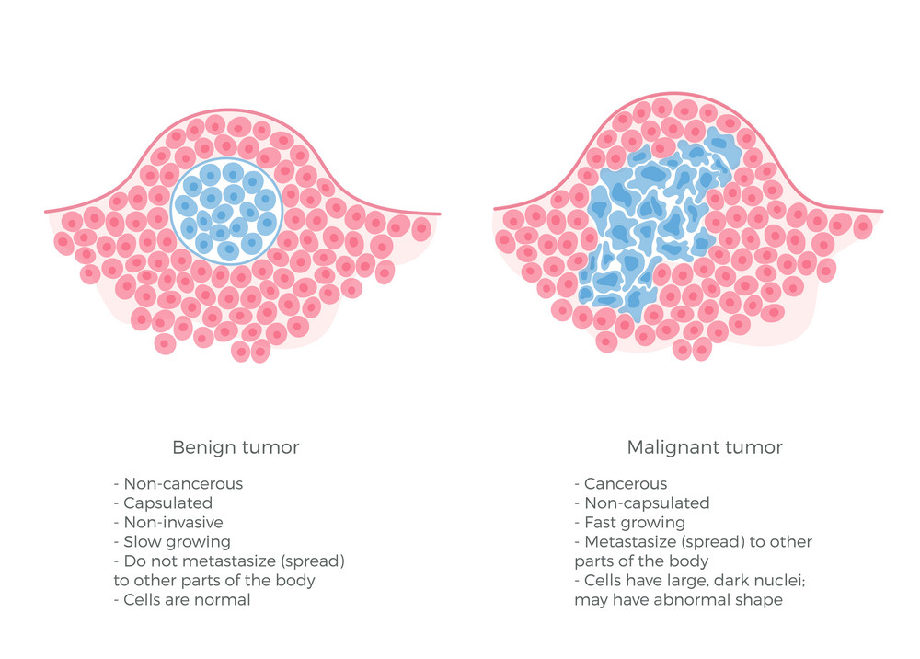
Project Overview and Objectives
The main objective of this project is to build multiply models that use the data's numerical values, that describe the geometric shape of a breast tumor, to predict if the subject's tumor is Malignant.
Malignant vs. Benign
The three main metrics used to classify performance for models are accuracy, recall, and precision. The main metrics I will use to justify my models are accuracy and recall.
I put a higher importance on my recall compared to accuracy and precision because it can become deadly if a person is told they don't have breast cancer and they move on without seeking necessary treatment.

Slide 3
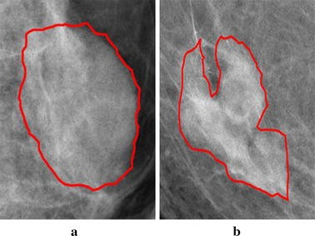
Data Description and Developing Hypotheses
The Categorical variable I am trying to predict is currently encoded as M for malignant and B for Benign, but I decided to encoded the malignant tumors as 1's and the benign tumors as 0's. There are a total of 27 features that describe the geometric shape of the breast tumor.
After subsetting the data, I found seven features that seem to have the most significance with the relationship of breast tumor diagnosis.
I constructed a linear relationship hypothesis for all the features comparing the relationship between the feature and the diagnosis.
For instance, There is no relationship between the diagnosis and the compactness_mean.
Then, I ran a t.test to see if I could reject my null hypothesis and not to my surprise, I reject all my null hypotheses because there was a significant relationship between each feature and the diagnosis.

Slide 4
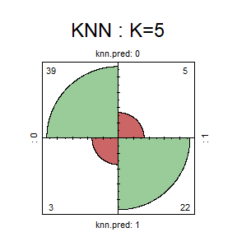
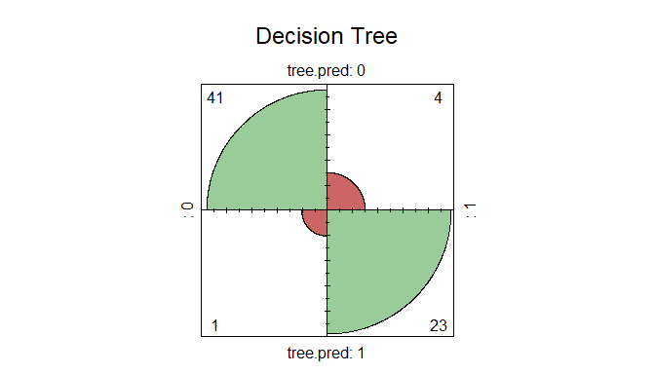
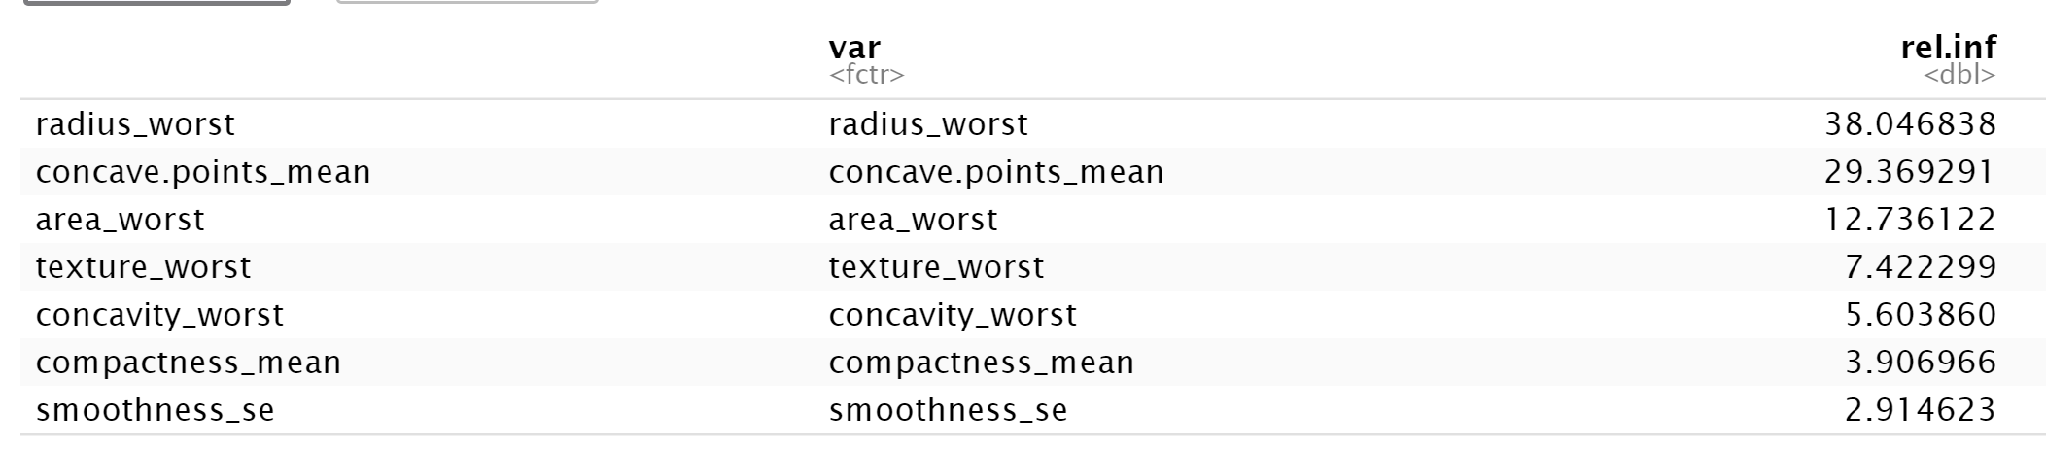
Developing and testing Models
The next step of the process after ensuring I am using the correct features in the data that mostly relate to the diagnosis of the breast tumor, is to build and test varies models to correctly predict whether a tumor is cancerous or not.
KNN, Decision Trees, and Random Forest
Random Forest
Random Forest

Slide 5
Conclusion
One of my high goals was to achieve a high accuracy and recall score or accomplish a small mean error value by building these varies models and using the geometric shape of a breast tumor to predict whether it was malignant or benign.
Overall, I was happy with my results of developing a KNN, decision tree, and random forest model where all of them seemed to stay above the 90% accuracy and 90% recall score.
It is still important to consider these models would never be allowed to be used in the medical field because 1/10 misdiagnosis is way too high, especially a 1/10 misdiagnosis resulting in a false negative that could end drastically poor.
Further research options?
Even though there is no cure, there is an opportunity to correctly diagnosis patients with breast cancer in the early stages with machine learning. Machine learning can create hope for the medical industry because if there is an algorithm that can correctly diagnosis patients at an extremely high rate or perfect rate, there may be an opportunity to save lives. This would allow doctors to focus on treatment and less on diagnosing because for some patients, time may be limited and every minute counts.

